Slide 1
Problem-solving using MapReduce/Hadoop
B. Ramamurthy
This is work is supported by NSF grant NSF-DUE-TUES-0920335 (Phase 2) &
NSF-ACI-1041280

Slide 2
Topics for Discussion
Problem solving approaches for big-data
Origins of MR/Hadoop
Algorithms, data structures and infrastructures
Hello “Wordcount”
  Wordcount mapreduce version
MapReduce
Hadoop
Linked structures
  PageRank mapreduce version
Infrastructure
  Local: Single node hadoop
  Local: CCR cluster
  Amazon aws cloud MR/Hadoop infrastructure
  Google appEngine Mapreduce

Slide 3
Big-data Problem Solving Approaches
Algorithmic: after all we have working towards this for ever: scalable/tractable
High Performance computing (HPC: multi-core) CCR has machines that are: 16 CPU , 32 core machine with 128GB RAM.
GPGPU programming: general purpose graphics processor (NVIDIA)
Statistical packages like R running on parallel threads on powerful machines
Machine learning algorithms on super computers

Slide 4
Different Type of Storage
Internet introduced a new challenge in the form web logs, web crawler’s data: large scale “peta scale”
But observe that this type of data has an uniquely different characteristic than your transactional or the “customer order” data, or “bank account data” :
The data type is “write once read many (WORM)” ;
  Privacy protected healthcare and patient information;
  Historical financial data;
  Other historical data
Relational file system and tables are insufficient.
Large <key, value> stores (files) and storage management system.
Built-in features for fault-tolerance, load balancing, data-transfer and aggregation,…
Clusters of distributed nodes for storage and computing.
Computing is inherently parallel

Slide 5
MR-data Concepts
Originated from the Google File System (GFS) is the special <key, value> store
Hadoop Distributed file system (HDFS) is the open source version of this. (Currently an Apache project)
Parallel processing of the data using MapReduce (MR) programming model
Challenges
  Formulation of MR algorithms
  Proper use of the features of infrastructure (Ex: sort)
  Best practices in using MR and HDFS
An extensive ecosystem consisting of other components such as column-based store (Hbase, BigTable), big data warehousing (Hive), workflow languages, etc.

Slide 6
Hadoop-MapReduce
MapReduce like algorithms on Hadoop-like infrastructures: typically batch processing
  Distributed parallelism among commodity machines
  WORM
  <key, value> pairs
Challenges
  Formulation of MR algorithms
  Proper use of the features of infrastructure (Ex: sort)
  Best practices in using MR and HDFS

Slide 7
MapReduce Design
You focus on Map function, Reduce function and other related functions like combiner etc.
Mapper and Reducer are designed as classes and the function defined as a method.
Configure the MR “Job” for location of these functions, location of input and output (paths within the local server), scale or size of the cluster in terms of #maps, # reduce etc., run the job.
Thus a complete MapReduce job consists of code for the mapper, reducer, combiner, and partitioner, along with job configuration parameters. The execution framework handles everything else.

Slide 8
The code
1: class Mapper
2: method Map(docid a; doc d)
3: for all term t in doc d do
4: Emit(term t; count 1)
1: class Reducer
2: method Reduce(term t; counts [c1; c2; : : :])
3: sum = 0
4: for all count c in counts [c1; c2; : : :] do
5: sum = sum + c
6: Emit(term t; count sum)

Slide 9
MapReduce Example: Mapper with Combiner
This is a cat
Cat sits on a roof
<this 1> <is 1> <a <1,1,>> <cat <1,1>> <sits 1> <on 1> <roof 1>
The roof is a tin roof
There is a tin can on the roof
<the <1,1>> <roof <1,1,1>> <is <1,1>> <a <1,1>> <tin <1,1>> <then 1> <can 1> <on 1>
Cat kicks the can
It rolls on the roof and falls on the next roof
<cat 1> <kicks 1> <the <1,1>> <can 1> <it 1> <roll 1> <on <1,1>> <roof <1,1>> <and 1> <falls 1> <next 1>
The cat rolls too
It sits on the can
<the <1,1>> <cat 1> <rolls 1> <too 1> <it 1> <sits 1> <on 1> <cat 1>

Slide 10
MapReduce Example: Combiner, Reducer, Shuffle, Sort
<this 1> <is 1> <a <1,1,>> <cat <1,1>> <sits 1> <on 1> <roof 1>
<the <1,1>> <roof <1,1,1>> <is <1,1>> <a <1,1>> <tin <1,1>> <then 1> <can 1> <on 1>
<cat 1> <kicks 1> <the <1,1>> <can 1> <it 1> <roll 1> <on <1,1>> <roof <1,1>> <and 1> <falls 1> <next 1>
<the <1,1>> <cat 1> <rolls 1> <too 1> <it 1> <sits 1> <on 1> <cat 1>
Input to the reducers:
<cat <1,1,1,1>>
<roof <1,1,1,1,1,1>>
<can <1, 1,1>>
…
Reduce (sum in this case) the counts: Can use non-traditional methods for summing
<cat 4>
<can 3>
<roof 6>

Slide 11
More on MR
All Mappers work in parallel.
Barriers enforce all mappers completion before Reducers start.
Mappers and Reducers typically execute on the same server
You can configure job to have other combinations besides Mapper/Reducer: ex: identify mappers/reducers for realizing “sort” (that happens to be a benchmark)
Mappers and reducers can have side effects; this allows for sharing information between iterations.
Notes:
er

Slide 12
Classes of problems “mapreducable”
Benchmark for comparing: Jim Gray’s challenge on data-intensive computing. Ex: “Sort”
Google uses it (we think) for wordcount, adwords, pagerank, indexing data.
Simple algorithms such as grep, text-indexing, reverse indexing
Bayesian classification: data mining domain
Facebook uses it for various operations: demographics
Financial services use it for analytics
Astronomy: Gaussian analysis for locating extra-terrestrial objects.
Expected to play a critical role in semantic web and web3.0
Probably many classical math problems.

Slide 13
Page Rank

Slide 14
General idea
Consider the world wide web with all its links.
Now imagine a random web surfer who visits a page and clicks a link on the page
Repeats this to infinity
Pagerank is a measure of how frequently will a page will be encountered.
In other words it is a probability distribution over nodes in the graph representing the likelihood that a random walk over the linked structure will arrive at a particular node.

Slide 15
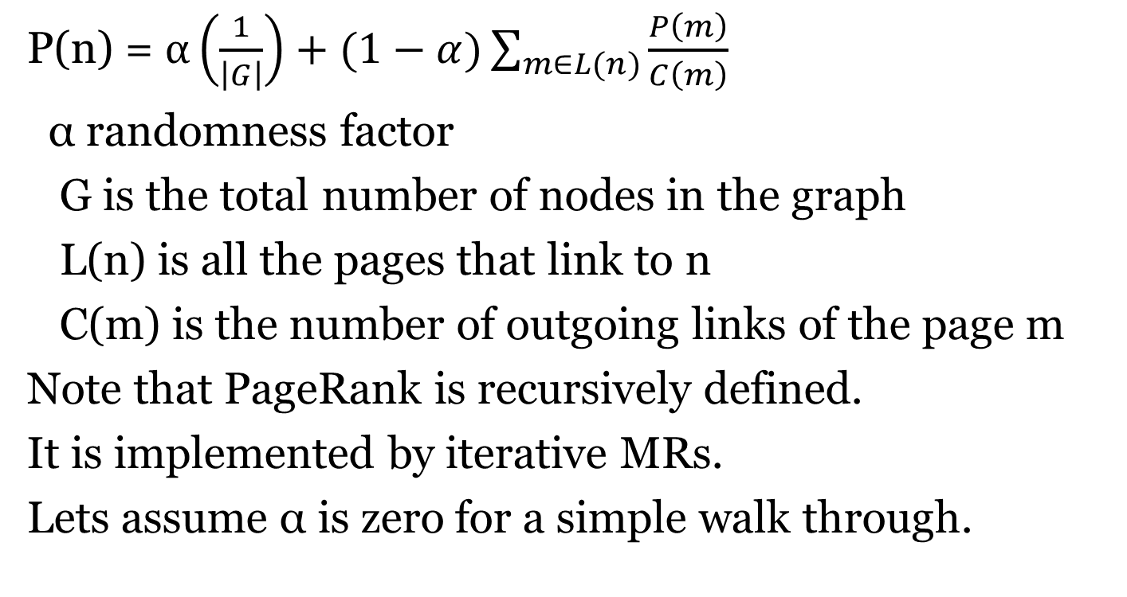
PageRank Formula
P(n) = $α\left(\frac{1}{\left|G\right|}\right)+(1−α)\sum_{m∈L(n)}{\frac{P\left(m\right)}{C\left(m\right)}}$
α randomness factor
G is the total number of nodes in the graph
L(n) is all the pages that link to n
C(m) is the number of outgoing links of the page m
Note that PageRank is recursively defined.
It is implemented by iterative MRs.
Lets assume α is zero for a simple walk through.

Slide 16
PageRank: Walk Through
0.066
0.166
0.2
0.2
n1
n2
n1
0.1
n2
0.033
0.1
0.066
0.033
0.1
0.066
0.1
0.1
0.083
0.1
0.083
n5
n5
0.3
0.2
0.2
0.066
0.3
0.1
n3
n3
n4
0.2
n4
0.166
0.2
0.166
0.2
0.3
0.1
0.133
n1
n2
n5
0.383
n3
n4
0.183
0.2

Slide 17
Mapper for PageRank
Class Mapper
method map (nid, Node N)
p ← N.Pagerank/|N.Adajacency|
emit(nid, N)
for all m in N. Adjacencylist
emit(nid m, p)
“divider”

Slide 18
Reducer for Pagerank
Class Reducer
method Reduce(nid m, [p1, p2, p3..])
Node M ← null; s = 0;
for all p in [p1,p2, ..]
{ if p is a Node then M ← p
else s ← s+p}
M.pagerank ← s
emit (nid m, Node M)
“aggregator”
At the reducer you get two types of items in the list.

Slide 19
Issues; Points to ponder
How to account for dangling nodes: one that has many incoming links and no outgoing links
  Simply redistributes its pagerank to all
  One iteration requires pagerank computation + redistribution of “unused” pagerank
Pagerank is iterated until convergence: when is convergence reached?
Probability distribution over a large network means underflow of the value of pagerank.. Use log based computation
MR: How do PRAM algs. translate to MR? how about math algorithms?

Slide 20
Demos
Single node: Eclipse Helios, Hadoop (MR)0.2, Hadoop-eclipse plug-in
Amazon Elastic cloud computing aws.amazon.com
CCR: Video of 100-node cluster for processing a billion node k-nary tree

Slide 21
References
Dean, J. and Ghemawat, S. 2008. MapReduce: simplified data processing on large clusters. Communication of ACM 51, 1 (Jan. 2008), 107-113.
Lin and Dyer (2010): Data-intensive text processing with MapReduce; http://beowulf.csail.mit.edu/18.337-2012/MapReduce-book-final.pdf
Cloudera Videos by Aaron Kimball:
http://www.cloudera.com/hadoop-training-basic
4. Apache Hadoop Tutorial: http://hadoop.apache.org http://hadoop.apache.org/core/docs/current/mapred_tutorial.html

Slide 22
Take Home Messages
MapReduce (MR) algorithm is for distributed processing of big-data
Apache Hadoop (open source) provides the distributed infrastructure for MR
Most challenging aspect is designing the MR algorithm for solving a problem; it is different mind-set;
  Visualizing data as key,value pairs; distributed parallel processing;
  Probably beautiful MR solutions can be designed for classical Math problems.
  It is not just mapper and reducer, but also other operations such as combiner, partitioner that have be cleverly used for solving large scale problems.

